Slide 1
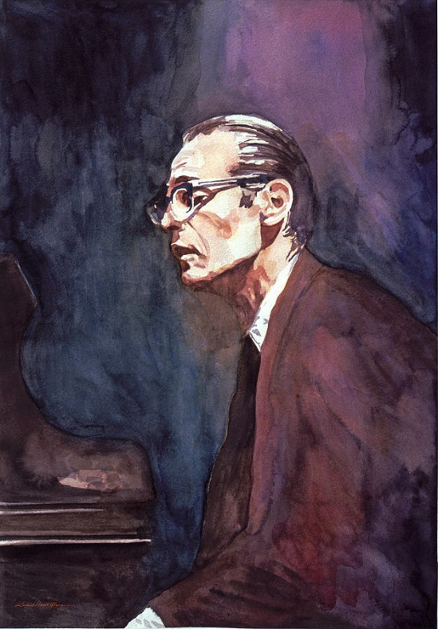
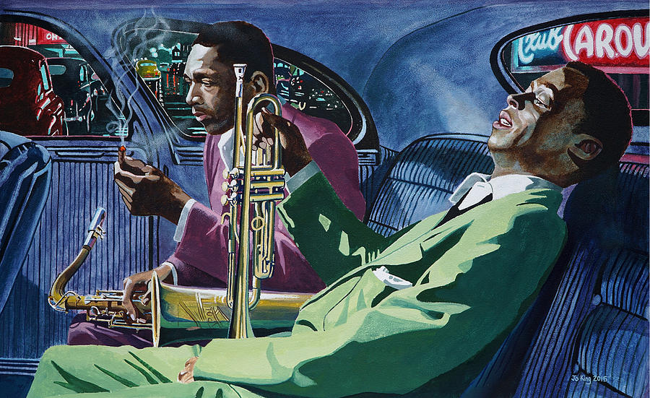
2110430 - Time Series Mining and Knowledge Discovery
Midterm Project:
Jazz Standards to Time Series Data

Slide 2
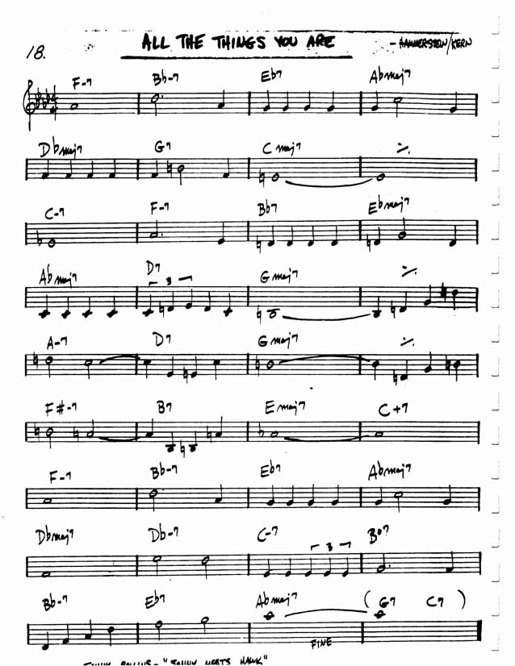
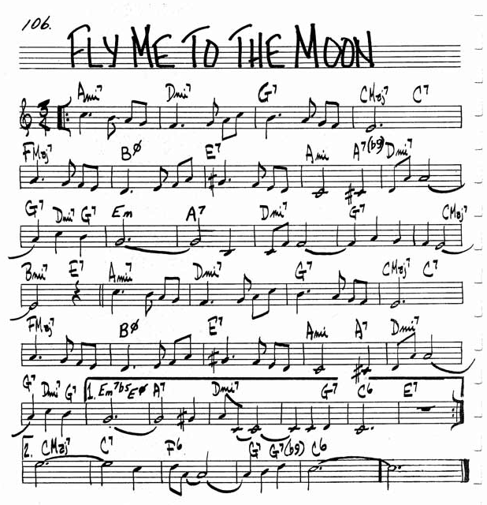
The Lead Sheets

Slide 3
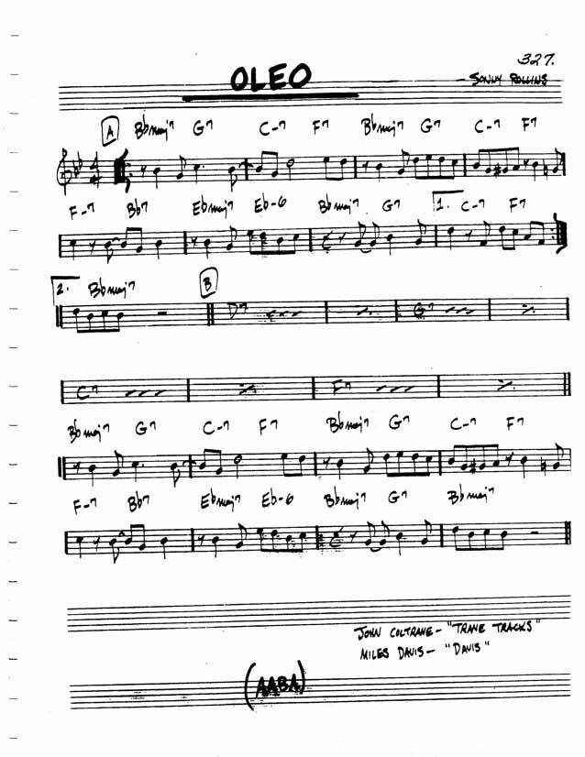
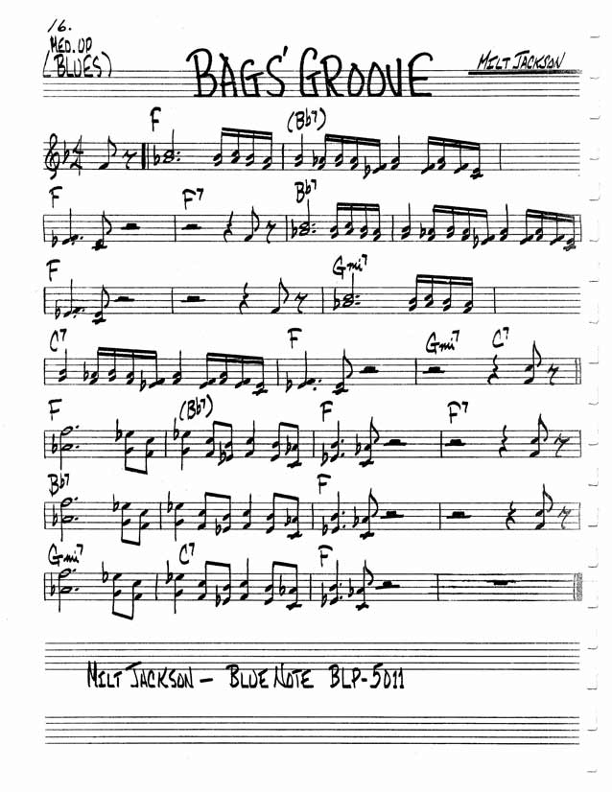
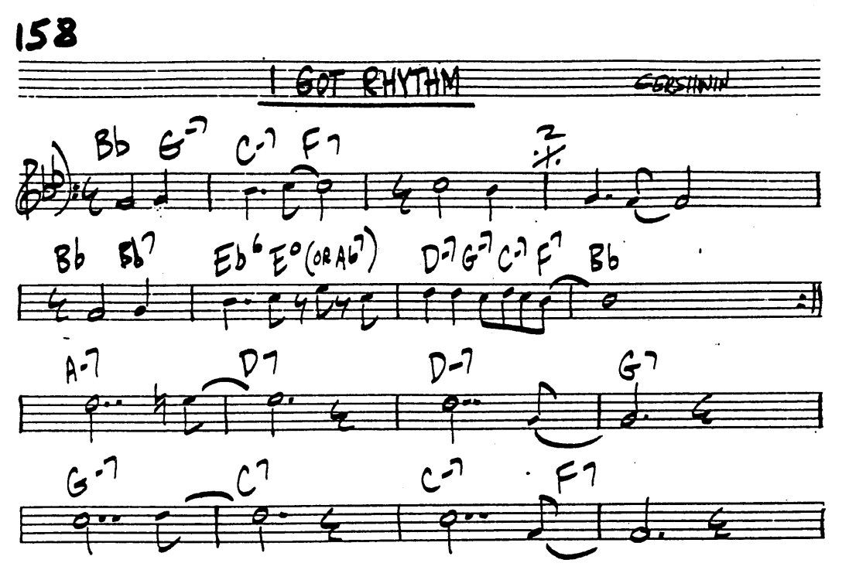
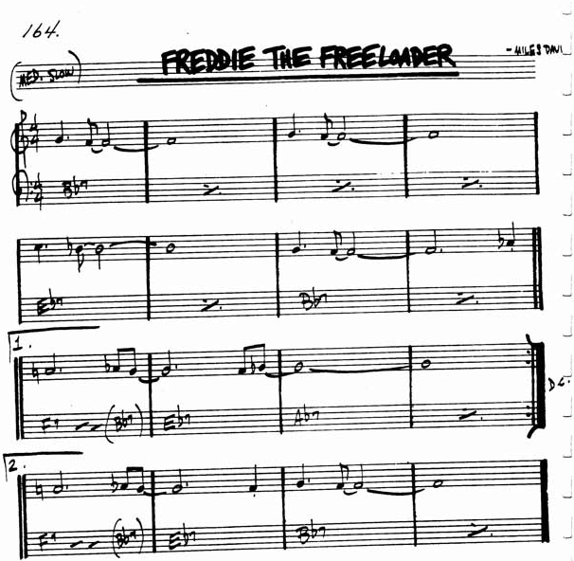
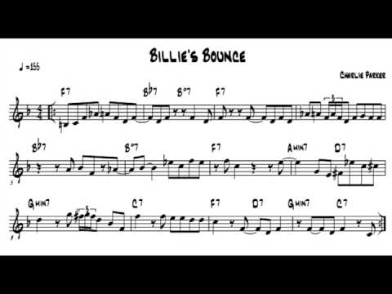
The Lead Sheets – Contrafacts and variations
Rhythm Changes
Blues

Slide 4
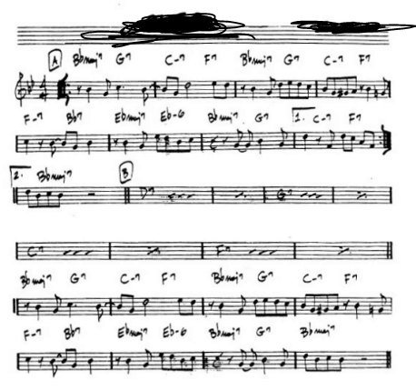
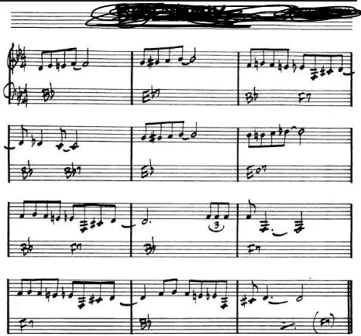
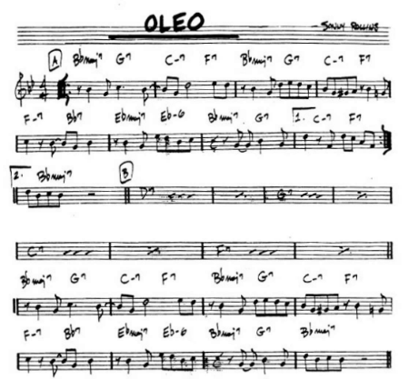
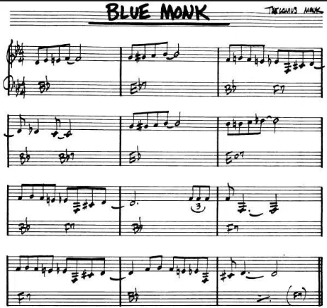
Please identify.

Slide 5
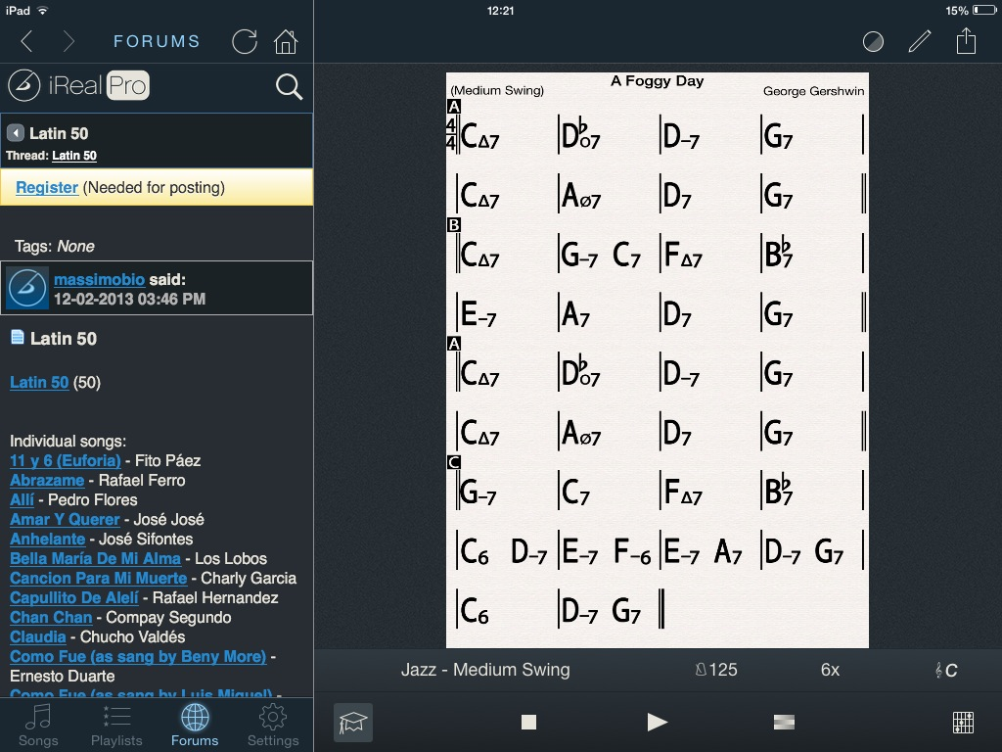
iRealpro
Chord charts can be exported to xml files

Slide 6
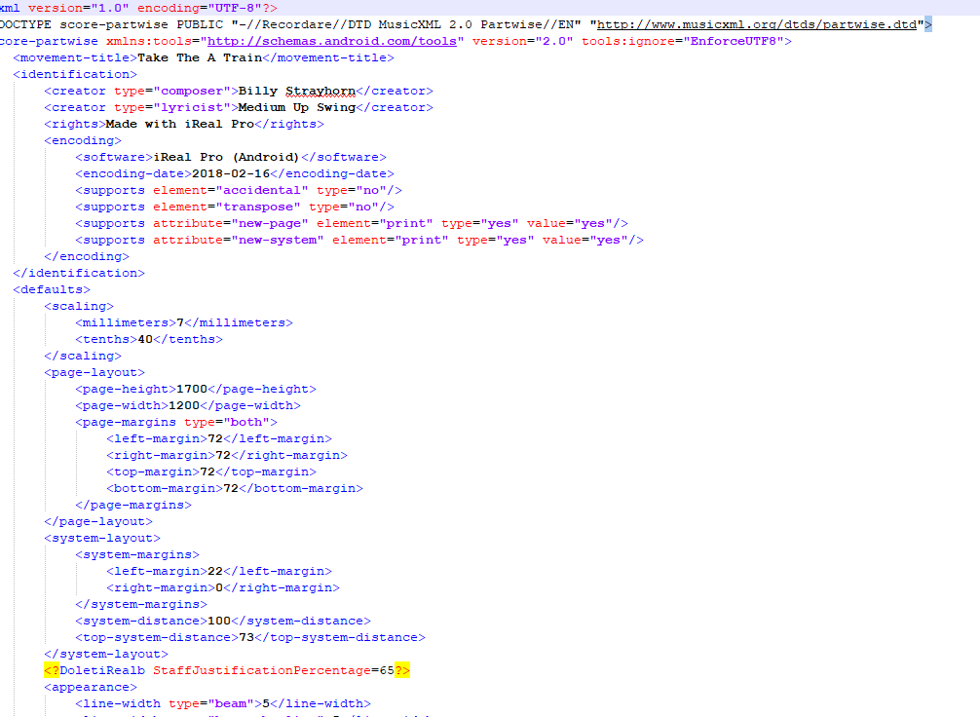
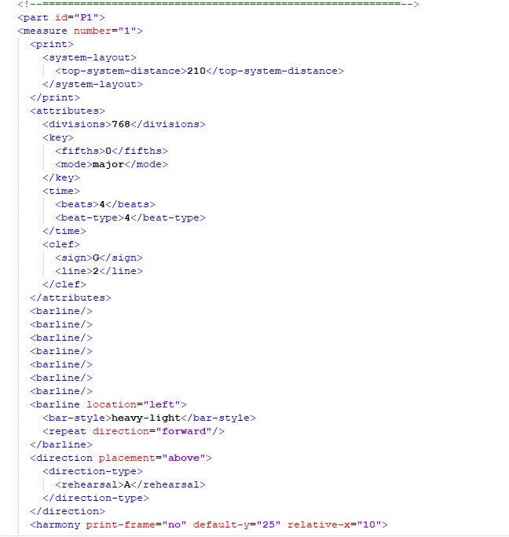
XML

Slide 7
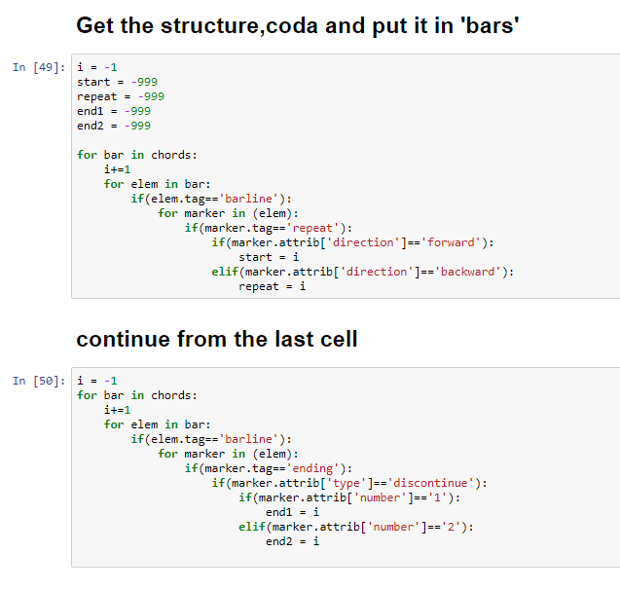
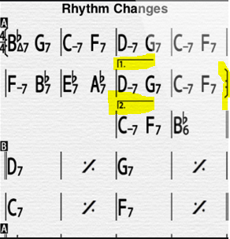
Get the song structures

Slide 8
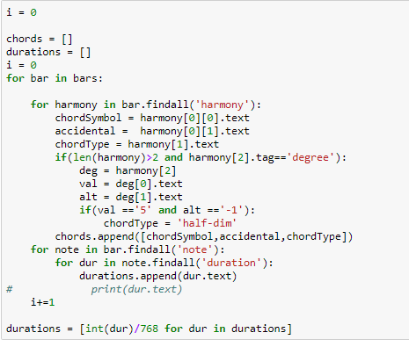
Extract the chords
“Half-Diminished (minor seventh flat five)”s have to be renamed

Slide 9
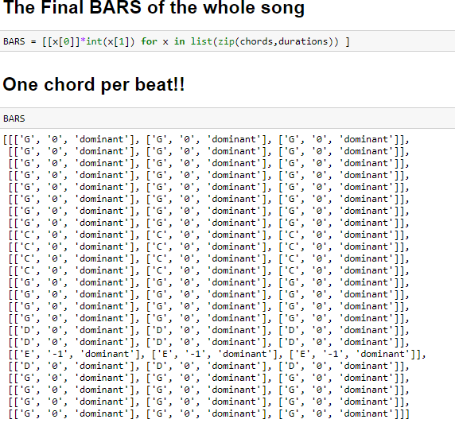
Put all chords into an array

Slide 10
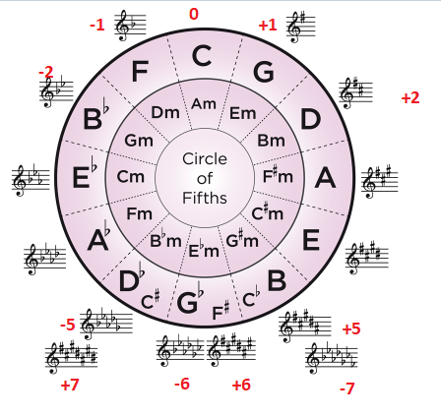
Mapping chord alphabets -> Integer
Enharmonic spellings are treated as different values

Slide 11
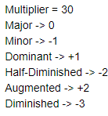
Map from ChordTypes -> Intergers
Sus chords are treated as major chords

Slide 12
The Function
F (x) = multiplier * x.chordTypeInteger + x.chordAlphabetInteger ;
x is a chord (e.g. “C major seventh” , “F minor seventh”, etc)
Multiplier = 30
chordTypes are {major, minor, dominant seventh, half-diminished, diminished, augmented}
chordAlphabets are {A, B, C, D, E, F, G}, with or without # or ♭
Store the result in an array, then plot the graph.

Slide 13
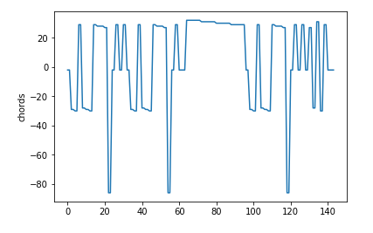
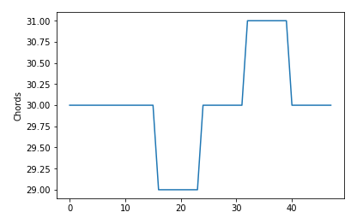
The results
I got rhythm (rhythm changes)
C-jam blues (Blues in C)

Slide 14
Let’s play!!

Slide 15
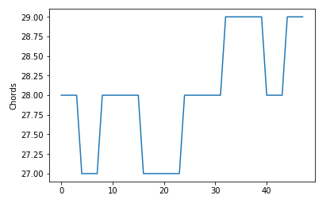
What kind of progressions of this tune?
C-jam blues (Blues in C)
I got rhythm (rhythm changes)
Straight no Chaser (Blues in Bb)

Slide 16
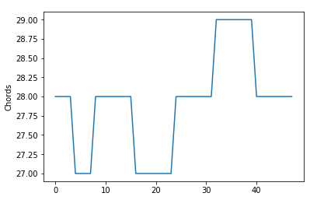
What kind of progressions of this tune?
C-jam blues (Blues in C)
I got rhythm (rhythm changes)
Blue Monk(Blues in Bb)

Slide 17
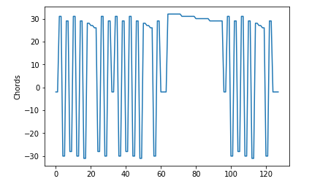
What kind of progressions of this tune?
C-jam blues (Blues in C)
I got rhythm (rhythm changes)
Anthropology (Rhythm Changes)

Slide 18
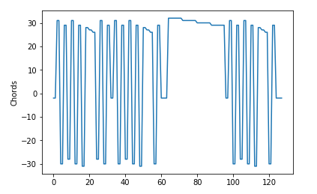
What kind of progressions of this tune?
C-jam blues (Blues in C)
I got rhythm (rhythm changes)
Oleo (Rhythm Changes)

Slide 19
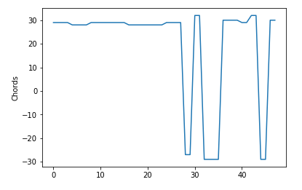
What kind of progressions of this tune?
C-jam blues (Blues in C)
I got rhythm (rhythm changes)
Bag’s groove(Blues in F)

Slide 20
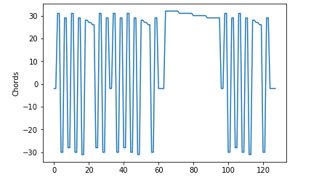
What kind of progressions of this tune?
C-jam blues (Blues in C)
I got rhythm (rhythm changes)
The Theme (Rhythm Changes)

Slide 21
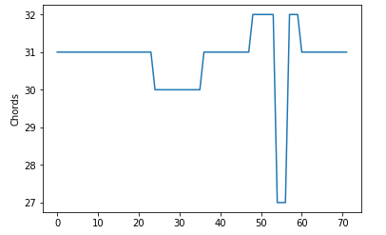
What kind of progressions of this tune?
C-jam blues (Blues in C)
I got rhythm (rhythm changes)
All Blues (Waltz blues in G)

Slide 22
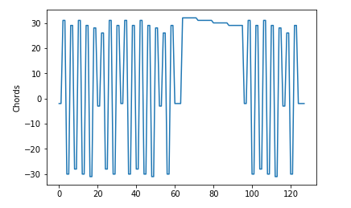
What kind of progressions of this tune?
C-jam blues (Blues in C)
I got rhythm (rhythm changes)
Dexterity (Rhythm Changes)

Slide 23
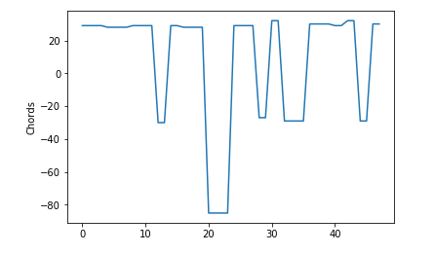
What kind of progressions of this tune?
C-jam blues (Blues in C)
I got rhythm (rhythm changes)
Billie’s bounce (Blues in F)

Slide 24
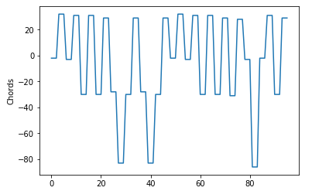
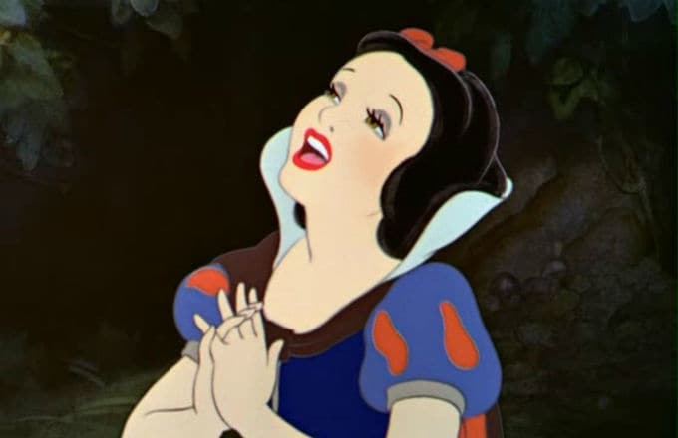
What kind of progressions of this tune?
C-jam blues (Blues in C)
I got rhythm (rhythm changes)
Someday my prince will come (neither)

Slide 25
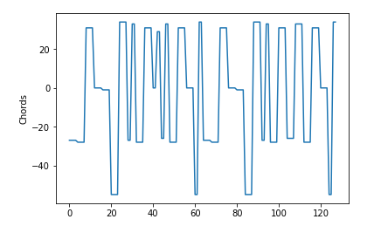
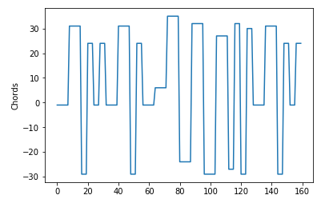
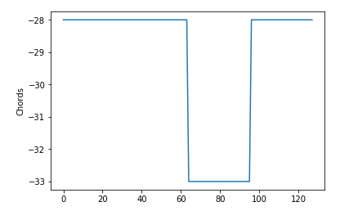
Other time series data from another jazz standards
Fly me to the moon
The girl from Ipanema
So what

Slide 26
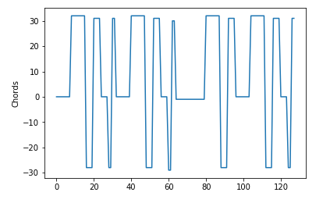
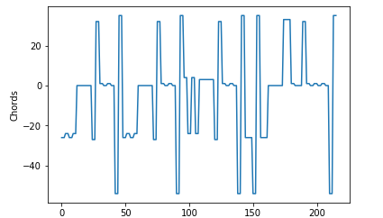
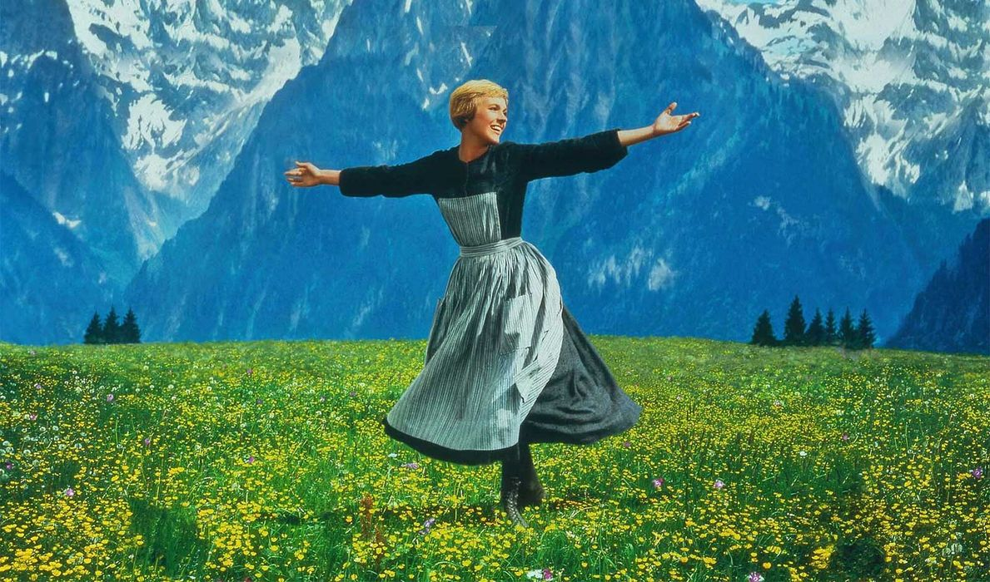
Other time series data from another jazz standards
Take the A train
My Favorite Things

Slide 27


The End

